Slide 1
ABOUT US
Encom Limited is a high technology indigenous company that was incorporated in Nigeria as a Limited Liability Company and provides services in the field of Engineering, Telecommunications and related discipline. The company is managed by highly qualified professional engineers, software experts and specialists with several years of experience both in Nigeria and Overseas. Through a unique combination of skills and experience, Encom is able to offer engineering and telecommunications services ranging from consultancy to turnkey project design, implementation and operation.
Encom has access to the specialized skills of leading experts in telecommunications and engineering in several countries to enhance its capabilities and to supplement its resources as may be required.

Slide 2
COMMITMENT
Encom’s commitment is to
Provide products and services that conform exactly to customer requirements
Meet those requirements without error on time and every time.
Deliver efficient services to customers with full understanding of their needs
MISSION STATEMENT
Encom’s mission is to ensure that telecommunication and IT services through collaborations get to the remotest part of Nigeria and beyond.

Slide 3
CONTACT US
Encom Limited
Peace Plaza B
Suite D06, 3rd Floor, Left Wing
Plot 481, Ajose Adeougn Street
Utako District
Abuja
Nigeria.
Tel: +234-903-4395129
+234-808-0652946
Email:
For enquiries: info@encomng.com
For Support: support@encomng.com
Website: www.encomng.com

Slide 4
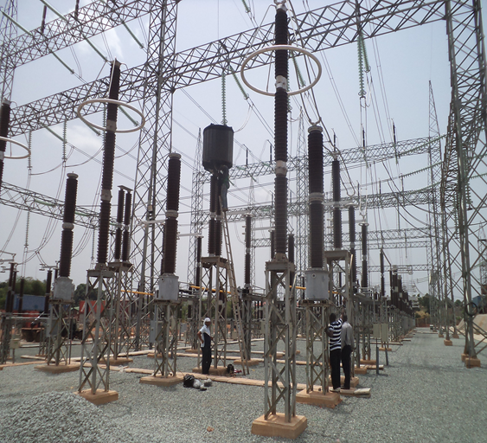
PRODUCTS AND SERVICES
ELECTRICAL POWER SYSTEM ENGINEERING
Power Line Carrier Communications including Line Traps, LMU, TX/RX Equipment, Coaxial cable, etc supply, installation and commissioning
Transformer, breaker, isolator, etc installation and commissioning
Substation construction
Tower assemble and erection
Power Line survey and substation audit
Line construction and conductor stringing
Protection and control as well as metering, etc
Rural Electrification Services
Power system equipment maintenance
Industrial cabling
Residential, Street and Warehouse wiring

Slide 5
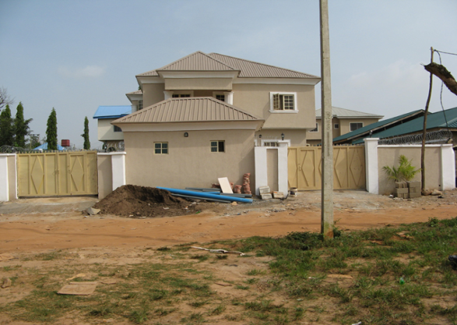
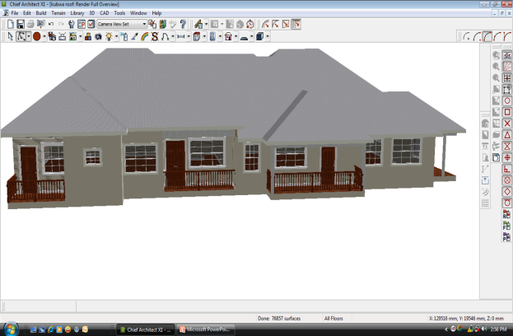
PRODUCTS AND SERVICES
BUILDING, CIVIL AND MECHANICAL ENGINEERING WORKS
We undertake turnkey engineering services including but not limited to the following:
Design
Building constructions
Road construction
Plumbing works
Maintenance and Renovation works
Compound and Floor finishing as well as painting
Landscaping
Architectural works

Slide 6



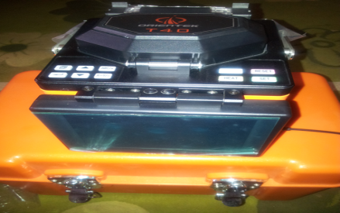
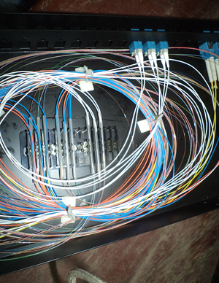
PRODUCTS AND SERVICES
FIBER OPTICS CABLE (FOC) DEPLOYMENT
FOC deployment for backbone (Short/Long/Extra Long/Ultra Long hauls) and City Metros. Implementation activities include but not limited to the following:
Procurement
Trenching and backfilling
Ducting
Drawing/blowing of fiber in duct
Installation on high voltage lines (330KV, 132KV) including ADSS, MASS and OPGW
Splicing
Termination
Testing
Preparation/Installation of Hand hole
Maintenance and relocation work

Slide 7
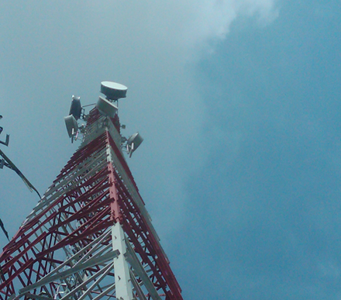
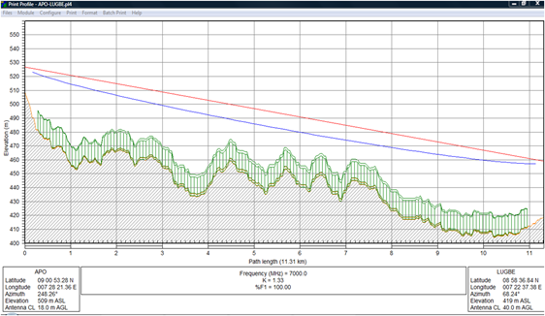
PRODUCTS AND SERVICES
MICROWAVE SYSTEM
We deploy point-to-point and point-to-multipoint system.
We undertake activities necessary for the actualization of a reliable microwave system such as:
Equipment procurement
Site survey
Line of Sight (LOS) survey
Path Profile and link analysis
Antenna specification
System design
Installation planning
Civil works
Site development
Commissioning
Training, etc.

Slide 8
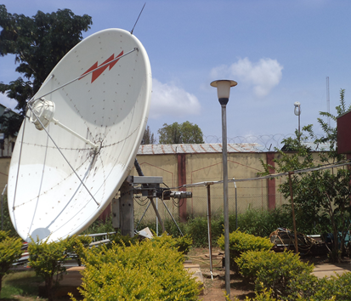
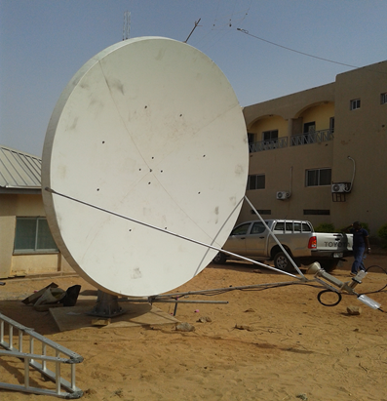
PRODUCTS AND SERVICES
VERY SMALL APERTURE TERMINAL (VSAT) Deployment
Encom deals on VSAT equipment from well-known
companies all over the world. Depending on
organization’s need, Star, Mesh, Star/Mesh, etc networks can be installed.
SYSTEM INTEGRATION
We will study your existing network and proffer integrating solutions that will enable new added products and features to optimize the existing system for better performance. We also carry out integration activities between an existing system or network with a new deployed system or network.

Slide 9
PRODUCTS AND SERVICES
COMPUTER SYSTEMS AND NETWORKS
We undertake the implementation of the following computer networks
Local Area Networks
Wide Area Networks
Metropolitan Area Network
Wireless Local Area Network
Fiber Optics network links

Slide 10
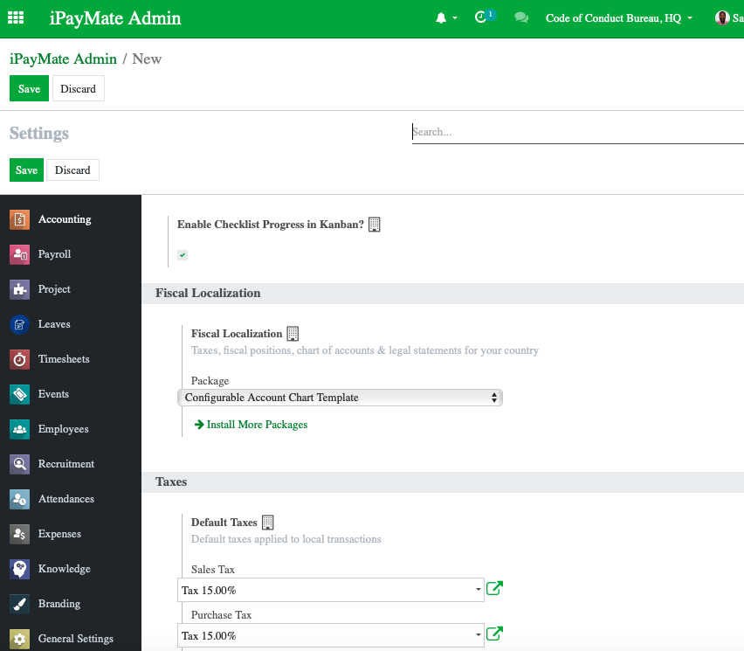
PRODUCTS AND SERVICES
SOFTWARE DEVELOPMENT AND DEPLOYMENT
We design and deploy Enterprise Resource Planning Software (iPayMateTM) for automation of clients operations.
Depending on customer requirements, the following can be automated
Human Resources
Finance and Accounts
Registry and Records
Training

Slide 11
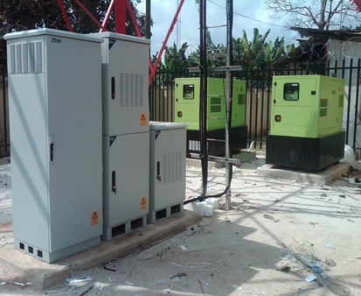
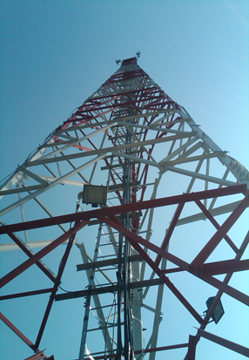
PRODUCTS AND SERVICES
TURN-KEY TELECOMMUNICATION STATION DEPLOYMENT
Site Construction
Site Access and Security
Site Power (Transformer, Generator, etc)
Power Protection and backup systems
(AVR, UPS, Rectifier, Inverter, Battery bank,
Solar system)
Tower/Mast erection and protection
(Thunder arrester, Aviation Light)
RF system (link engineering and equipment
installation)
Premises/Equipment/Tower/Mast earthing
Equipment shelter deployment
Site maintenance

Slide 12
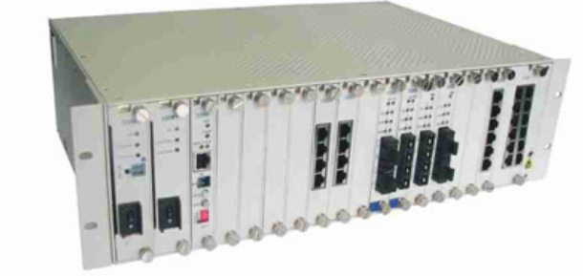
PRODUCTS AND SERVICES
MULTI-SERVICE PROVISIONING SYSTEMS
Service rendering includes SDH,PDH, SONET, DWDM for enterprise and service providers, etc.
Deployment activities include:
Procurement
Site Survey
Network Design
Installation and Configuration
Testing and commissioning
Maintenance Services
Spare Stocking
STM-1/4/16 Multiplexer Optical
Multi-Service Provisioning Platform
Ultra-Long-Haul DWDM System
(Eliminates LAs & Repeaters
from Spans >300 km)

Slide 13
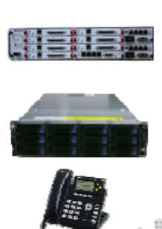


PRODUCTS AND SERVICES
ENTERPRISE PRODUCTS AND SOLUTIONS
Unified Communication including Call Manager Solution, Call Center, etc
PABX System including IP
Surveillance Security system including CCTV solutions
Audio/Video conferencing
Telepresence systems
Broadband solutions
Document Management System
Satellite television, etc
Telepresence/Video Conference
Solution
IP Pabx/UC
Solution
CCTV
Solution

Slide 14
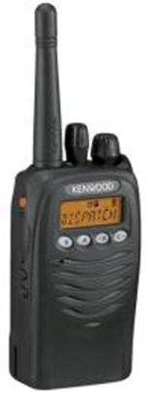
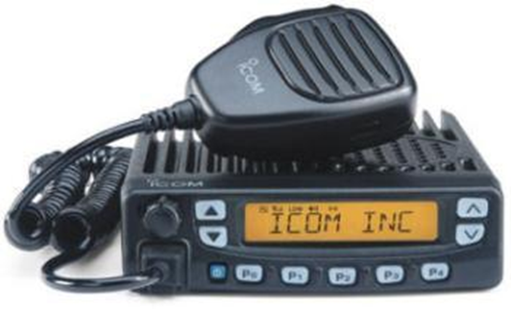
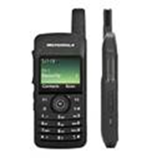
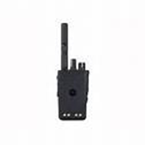
PRODUCTS AND SERVICES
2-WAY RADIO SYSTEMS
The common radio system we deal on from design to implementation levels includes Icom, Yeasu, Motorola, Codan, Barrett, Tait and Mac.

Slide 15
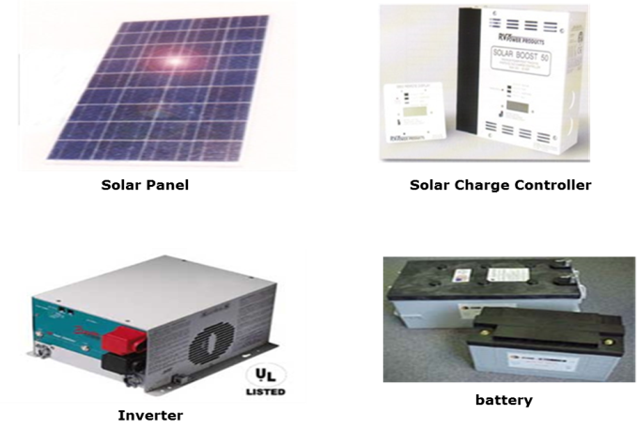
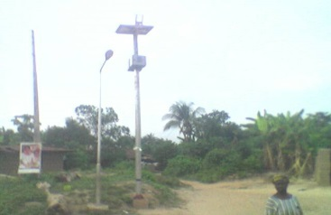
PRODUCTS AND SERVICES
POWER CONTROL SOLUTIONS
To ensure that your sensitive electronics operate at peak performance, Encom provides power products and solutions to support all of your communications needs. These products include:
Solar power system including design, procurement, installation, commissioning and maintenance
Battery backup system
Inverter Systems
Uninterruptible power systems
Automatic voltage regulators
Surge suppressors
Lightning/Thunder arresters
Solar Street Light

Slide 16
PRODUCTS AND SERVICES
CONSULTANCY SERVICES
Full range of consulting services we provide includes:
Network design
Contract negotiation
Feasibility study
Project management
Tender document preparation and bid management
Strategic planning
Telecommunication auditing
Site acquisition
Microwave Line of Site Survey
Construction management
Project implementation supervision
Training, etc

Slide 17
PRODUCTS AND SERVICES
EQUIPMENT INSTALLATION
Equipment installation activities include but not limited to the followings:
Equipment procurement
Site survey
Implementation Planning
Design
Civil works
Project management
Grounding and Protection
Equipment setup, testing, commissioning

Slide 18
PRODUCTS AND SERVICES
EQUIPMENT MAINTENANCE
Equipment after installation and commissioning needs periodic maintenance in order to:
Prolong the lifespan.
Improve staff productivity
Reduce man-hour loss
Detect early malfunction and faults
Encom provides the following maintenance services:
Daily routine maintenance
Quarterly Preventive maintenance
Annual Maintenance checks
Corrective maintenance
Call Out Maintenance Service
Technical Support
Spare stocking

Slide 19
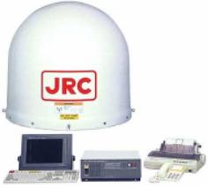
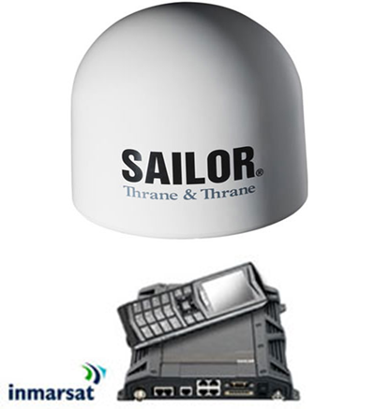
PRODUCTS AND SERVICES
INMARSAT SYSTEMS
Inmarsat types B, Mini M, M4, RBGAN (Inmarsat terminal used mainly for data and Internet access) and Inmarsat Fleet from JRC, NERA, Thrane & Thrane, and Anritsu are the Inmarsat terminals we supply, install, commission and maintain.

Slide 20
CLIENTELE
Encom has provided services for the following companies
Nigerian National Petroleum Corporation (NNPC)
CITCC Nig. Limited
CCECC Nig. Limited
Abuja Municipal Management Council (AMMC), FCTA
Code of Conduct Bureau
Nigerian Educational Research and Development Council (NERDC)
West African Seasoning Co. Limited
INEC
Federal Roads Maintenance Agency (FERMA)
Gizzini International Limited
Bedding Holdings Limited
Computer Warehouse Group
Ad-Alloy Precision Man’f Limited
Adorbel Nigeria Limited
TTI Limited
PPC Limited
Julius Berger Nig. Ltd
Zadub Engineering Limited, etc
Dantata and Sawoe Nigeria Limited

Slide 21
EXPERIENCE
Electrical Power System
Erection Activities (Installation of Line Traps, Line Matching Units, Coaxial cables and termination to PLC equipment, fiber optics approach cable installation for SDH equipment , splicing and termination in Patch panels, integration activities) in 13 TCN Switchyards for PPC Limited – August 2008 to Date
Routine Maintenance and Security of Street Lights in Central Business District and Embassy Zone, Abuja for FCTA/AMMC –Ongoing, June 2017
Relocation of High Tension Electric Cables along the Railway Corridor of Abuja Rail Mass Transit Project for CCECC Nig. Limited – Oct 2014-June 2015
Installation of ADSS Fiber Optic cable on Ajah – Egbin 330KV transmission line, a distance of 19Km for PPC Ltd - Ongoing
c) TCN Power lines survey and audit of power station facilities and substations preparatory for Fiber Optics Cable deployment on High Tension (330KV and 132KV) lines throughout Nigeria for Alheri Engineering Co. Ltd, a subsidiary of Dangote Group. July – August 2006

Slide 22
EXPERIENCE
Radio System (Backhaul) Deployment
(a) Turnkey relocation of 2 NITEL/MTEL GSM and CDMA Radio base stations along Airport road, Abuja for Julius Berger Nig. Ltd. Nov. 2009 to March 2010
Installation of BTS, Generator and Microwave radio system for CITCC at Yobe, Zamfara, Katsina, Kano, Akwa Ibom, Edo, Anambra, Ebonyi and Rivers States. Sept. 2011 to April 2013
Installation of BSC (Switch room) equipment in Akwa Ibom for CITCC Nig. Ltd
Dec 2011 to April 2013.
(d) Transfer of radio services including link commissioning from decommissioned Masts to Towers in four NNPC Locations in Lagos
September 2018.

Slide 23
EXPERIENCE
Fiber Optics Backbone Infrastructure
Installed fiber optics cable backbone infrastructure for NNPC depots in Mosimi, Warri, Benin and Kaduna . Dec. 2005 – February 2006.
Activities carried out included:
Soil excavation and backfilling including concreting where necessary.
Ducting and fiber optics cable drawing.
Fiber splicing and termination in patch panels.
Installation of fiber transceivers
optimization of the existing LAN at the locations and replacement of Hubs with switches
Connection of the LAN to the Fiber Optics Network
Integration of the entire system to the VSAT equipment via router for Wide Area Network (WAN) connections
Performed fiber link test, LAN connectivity test and WAN test
2) Repair of damaged Fiber Optics cable at NNPC depot, Mosimi. - April 2007
Activities included: provision of 4 core single mode fiber optics cable, underground joint closures, underground iron protection sleeves, PVC ducts, galvanized steel pipes, excavation, backfilling and compaction, casting, fiber jointing and link tests

Slide 24
EXPERIENCE
VSAT System
Relocated VSAT Remote Station from old site to new site at Bonny Oil Terminal for NNPC. June 2011
Reactivated VSAT Remote stations at Biu, Maiduguri and Zaria locations for NNPC. August 2011
Frequency realignment of VSAT Remote stations in Warri Telecom Area for NNPC. July 2011
Supply and Installation of 150Watts C-Band SSPA for Hub operation for NNPC. February 2012
Supply, installation and programming of Control Channel Module Controller for Hub station for NNPC. February 2012
Gilat Faraway VSAT Network relocation from Intelsat 801 to Intelsat 707 for NNPC. NNPC VSAT is made up of 2 Hub stations, 6 Nodal stations and 50 remote stations. The relocation involved frequency change and parameters programming based on SSOG from Intelsat, antenna movement from Intelsat 801 location to Intelsat 707 locations, testing and commissioning. Dec. 2008 to March 2009
Reactivated VSAT stations in Ore, Ilorin, Calabar, Atlas Cove, Egbin, Calabar and Ewekoro Depots for NNPC, June to July 2009
VSAT Internet connection for the following:
Nigerian Educational Research and Development Council (NERDC) - 2008
Bill Bisad Firm Ltd - 2007

Slide 25
EXPERIENCE
Multiplexing Equipment
Supply and installation of RAD Optimux-108 E1 and Ethernet fiber multiplexer for locations in Kaduna Telecom Area. Work scope included equipment and installation materials procurement, installation, configuration and integration to the existing Pabx systems as well as testing. NNPC
Surveillance Security System
1. Supply and installation CCTV system for The PrimeRose International Academy for the School surveillance July 2019
2. Encom designed, supplied and installed surveillance security system (CCTV cameras, Monitor) for West African Seasoning Co. Ltd. for monitoring of various sections and production activities in the factory. (2003, 2004)
VPN Security
Procured, installed and configured CISCO security bundle router (1841) and security bundle firewall (506E) for INEC’s 13 State offices ( Lagos, Enugu, Abeokuta, Benin, Asaba, Awka, Abakaliki,Umuahia, Owerri, Yenagoa, PH, Uyo, Calabar). The project aimed at protecting the commission’s data and sensitive information against Internet threats during remote access. A subcontract from Proper Communications Ltd. (2005)
Equipment Installation
Encom Ltd as one of AD-Alloy contractors, project managed the entire HF Radio Voice/Data project for INEC and participated in the equipment installation and commissioning of fixed stations in 8 INEC State offices (FCT, Benin, Asaba, Awka, Enugu, Abakaliki, Owerri, Umuahia and 6 fixed stations and 2 mobile stations in the Headquarters. (2002-2003)

Slide 26
EXPERIENCE
Equipment Maintenance
Telecom facilities maintenance for NNPC Port Harcourt Area – September 2008 to 2010 Help Desk, daily maintenance and quarterly maintenance services are provided for all telecom facilities including VSAT, Radios, PABX systems, power control equipment, local line plants, etc
Solar Power System
1) Installed 5KVA Solar power system for Nigerian Educational Research and Development Council. February 2008
2) Resuscitated Solar power system for NNPC Afam Gas Station for Zadub Engineering Ltd – February 2010
Consultancy
(a) Telecommunication Audit
Encom participate the technical audit of the network of the following companies
NNPC (VSAT Network) 2000
NPA (Telecommunications Network) 2001
Nigerian Railway Corporation (Microwave Radio Network) 2002
INEC (Telecommunications and Computer networks) 2001
(b) Network Design/Supervision
NNPC (VSAT Network)–Network design and installation supervision. 2001
NAMA (SATCOM Network) – Optimization supervision. 2001
ABU Zaria (VSAT Internet and WLL) – Network design and installation supervision. 2002

Slide 27
EXPERIENCE
Computerization of INEC Polling Units
Encom Ltd as part of Adorbel subcontractors provided managerial, planning, coordination and supervisory activities for the actualization of INEC Pooling Units computerization project. Job scope included the collection of polling unit data (GPS information, digital image capture and descriptive information), data collation and population in the zonal server as well as field supervision. ( March – Sept. 2004)
Bid Document Preparation/Response and Evaluation
Alheri Engineering Co. Ltd (NEPA FOC Commercialization Expression of Interest and Response to Tender packages respectively). Oct 2004 – April 2005)
ABU Zaria (VSAT Internet Connection/Wireless Radios for Cyber Cafe). 2002
Training
ERP Training for Code of Conduct Bureau – September 2019
INEC (Codan NGT HF Radio technical and Operation Training for Engineers and Operators) 2013
Nigeria Immigration Services (Codan NGT HF Radio Operation and Maintenance Training. Sept. 2011 - June 2012
Hexton Ltd (Network Security Training – INEC Staff). April 2005
Codan NGT HF Radio Operation Training) 2003
Licensing
Alheri Engineering Co. Ltd (NCC Long Distance Operator License) 2005
Shell (Inmarsat) 2000
Japan Gas Company (JGC) Ltd (INMARSAT) 2000
West African Seasoning Co. Ltd (Inmarsat) 2000

Slide 28
EXPERIENCE
Towers and Masts Deployment
6Nos 45m Towers for NNPC Locations in Lagos – Dec 2017 to September 2018
2Nos 45m mast for radio repeater antenna (AMMC, Abuja) – Dec 2010-Jan 2011
2Nos 43m Tower Relocation (Julius Berger Nig. Plc). Nov.2009 – March 2010
45m Mast Relocation for Dantata and Sawoe Nig. Ltd. April 2010
3Nos 36m masts for radio repeaters (INEC state offices in Enugu,Abakaliki, Owerri) - 2003
2-Way HF/VHF Radio Communication
Reactivation of HF Radio for INEC HQ and FCT Office Dec 2012 – Jan 2013
Abuja Municipal Management Council (AMMC), FCDA-(VHF Radio Supply and Installation). Dec. 2010 – January 2011
INEC - Reactivation of HF Radio. 2007
INEC – Reactivation of VHF Radio. 2007
Networking (LAN)
Deployed advance LAN infrastructure for the following companies:
Upgrade of LAN Infrastructre at INEC Training and Electoral Institute, Abuja-Dec 2015 – Feb 2016
NNPC Telecom Center, Warri – October 2008
NNPC Telecom Center, Port harcourt – October 2008
Installed LAN in INEC Zonal Processing Centers in Enugu, Abakaliki, Port Harcourt and Minna (2005)
PABX System
Supplied, installed and commissioned digital Pabx system for the following:
West African Seasoning Co. Ltd., Lagos, 2006
Magnet Communications Ltd, Lagos: Ekiti State Governement House), 2007
INMARSAT System
Supplied, installed and commissioned JRC, NERA, Thrane & Thrane Inmarsat equipment for the following companies.
West African Seasoning Co. Ltd., Lagos
INEC Headquarters, Abuja on behalf of Bedding Holdings Ltd

